Slide 1
Structure of C Programs
It's time to write your first C program.

Slide 2
Structure of a C Program

Slide 3
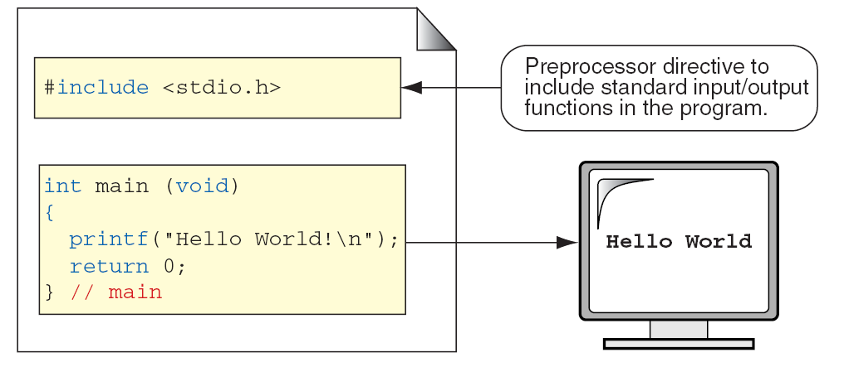
Greeting Program

Slide 4
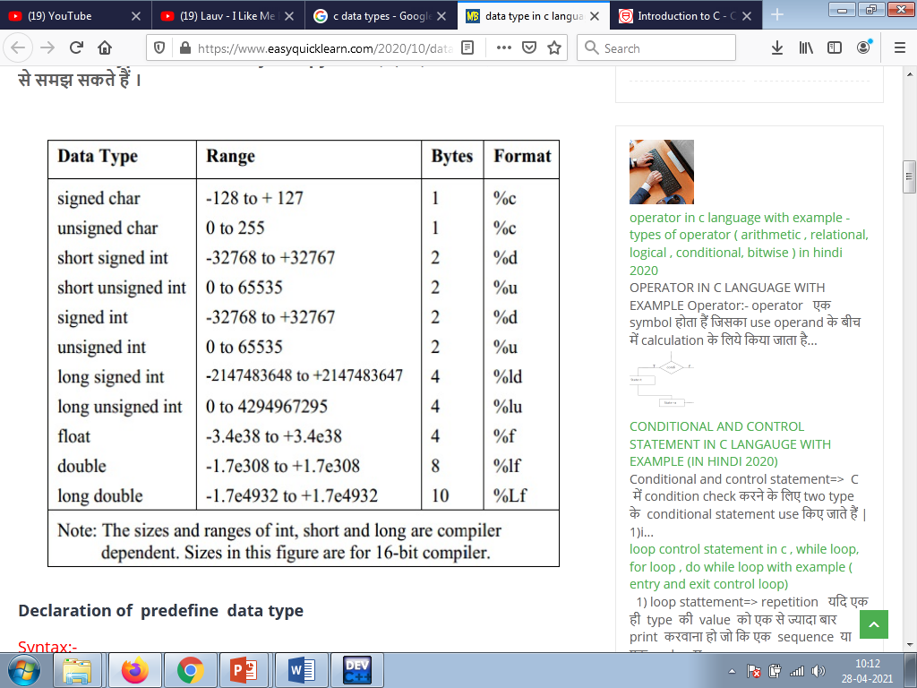
Type Summary

Slide 5
Example
Write a program to find area & circumference of circler
#include<stdio.h>
Void main()
{
Float r,a,cr;
Printf(“Enter the radius of circle”);
Scanf(“%f”,&r);
a= 3.14*r*r;
C=2*3.14*r;
Printf(“\n Area=%f”,a);
Printf(“curcumference=%f”, c);
}

Slide 6
Operators in c

Slide 7
Arithmetic Operators in C
Name Operator Example
Addition + num1 + num2
Subtraction - initial - spent
Multiplication * fathoms * 6
Division / sum / count
Modulus % m % n

Slide 8
Division
If both operands of a division expression are integers, you will get an integer answer. The fractional portion is thrown away.
Examples : 17 / 5 = 3
4 / 3 = 1
35 / 9 = 3

Slide 9
Division (con’t)
Division where at least one operand is a floating point number will produce a floating point answer.
Examples : 17.0 / 5 = 3.4
4 / 3.2 = 1.25
35.2 / 9.1 = 3.86813
What happens? The integer operand is temporarily converted to a floating point, then the division is performed.

Slide 10
Division By Zero
Division by zero is mathematically undefined.
If you allow division by zero in a program, it will cause a fatal error. Your program will terminate execution and give an error message.
Non-fatal errors do not cause program termination, just produce incorrect results.

Slide 11
Modulus
The expression m % n yields the integer remainder after m is divided by n.
Modulus is an integer operation -- both operands MUST be integers.
Examples : 17 % 5 = 2
6 % 3 = 0
9 % 2 = 1
5 % 8 = 5

Slide 12
Uses for Modulus
Used to determine if an integer value is even or odd
5 % 2 = 1 odd 4 % 2 = 0 even
If you take the modulus by 2 of an integer, a result of 1 means the number is odd and a result of 0 means the number is even.

Slide 13
Arithmetic Operators Rules of Operator Precedence
Operator(s) | Precedence & Associativity
( ) | Evaluated first. If nested (embedded), innermost first. If on same level, left to right.
* / % | Evaluated second. If there are several, evaluated left to right
+ - | Evaluated third. If there are several, evaluated left to right.
= | Evaluated last, right to left.

Slide 14
Using Parentheses
Use parentheses to change the order in which an expression is evaluated.
a + b * c Would multiply b * c first, then add a to the result.
If you really want the sum of a and b to be multiplied by c, use parentheses to force the evaluation to be done in the order you want.
(a + b) * c
Also use parentheses to clarify a complex expression.

Slide 15
Logical operators
&& Logical AND
|| Logical OR
! Logical NOT
gives a boolean result
boolean b;
b = 3 > 2 && 5 < 7; // b is true
b = 2 > 3 && 5 < 7; // b is now false
if the result can be determined from first clause, 2nd will not be evaluated

Slide 16
Relational operators
< Less than
<= Less than or equal to
> Greater than
>= Greater than or equal to
These all have the same precedence, and it is higher than equality/inequality tests

Slide 17
Equality and inequality
== Test if equal
For primitive types, tests if the values are equal
For objects, tests if both sides refer to the same object
!= Test if not equal
For primitive types, tests if the values are unequal
For objects, tests if the sides refer to different objects
Reminder: these tests should not be used on floating-point numbers (float or double)

Slide 18
AND
& AND
For integral types, ANDs each corresponding pair of bits
0 & 0 == 0 0 & 1 == 0 1 & 0 == 0 1 & 1 == 1
For booleans, performs the logical AND operation
Boolean & is like &&, but both operands are evaluated, even if it is possible to decide the result from the left operand alone

Slide 19
Exclusive OR
^ XOR
For integral types, XORs each corresponding pair of bits
0 ^ 0 == 0 0 ^ 1 == 1 1 ^ 0 == 1 1 ^ 1 == 0
For booleans, performs the logical XOR operation
a ^ b is true if either a is true or b is true, but not both
There is no ^^ operation

Slide 20
OR
| OR
For integral types, ORs each corresponding pair of bits
0 | 0 == 0 0 | 1 == 1 1 | 0 == 1 1 | 1 == 1
For booleans, performs the logical OR operation
Boolean | is like ||, but both operands are evaluated, even if it is possible to decide the result from the left operand alone

Slide 21
The ternary operator
boolean-expr ? expression-1 : expression-2
This is like if-then-else for values rather than for statements
If the boolean-expr evaluates to true, the result is expression-1, else it is expression-2
Example: max = a > b ? a : b ; sets the variable max to the larger of a and b

